Slide 1
International Workshop on Updated Recommendations in the Trade Statistics Manuals IMTS 2026 and MSITS 2026 14-16 April 2025/ Muscat, Oman,
Using R and Python for processing trade data at the Palestinian Central Bureau of Statistics (PCBS)

Slide 2
Table of Contents
Introduction to the Data Science Initiative in Palestine
Concepts
Project Aspects
Project Stages
Project Significancy
Future Plans

Slide 3
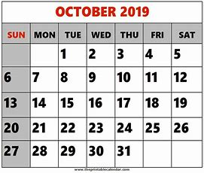

Slide 4
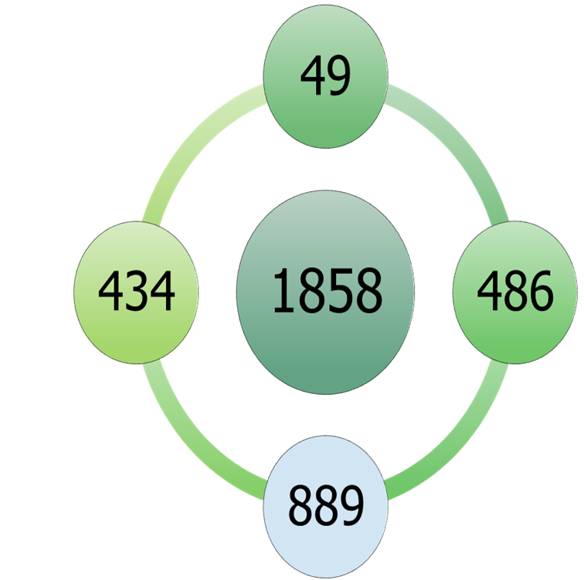
Received applications
Professional certificate in Data Science, Harvardx
Final List

Slide 5
Final applicants list by sector
889
International Ogr& Associations
Unemployed
Private sec.
Gov. Emp.
21
78
507
145
138

Slide 6
Final applicants list by sector
889
International Org.& Associations
Unemployed
Private sec.
Gov. Emp.
21
78
507
145
138

Slide 7
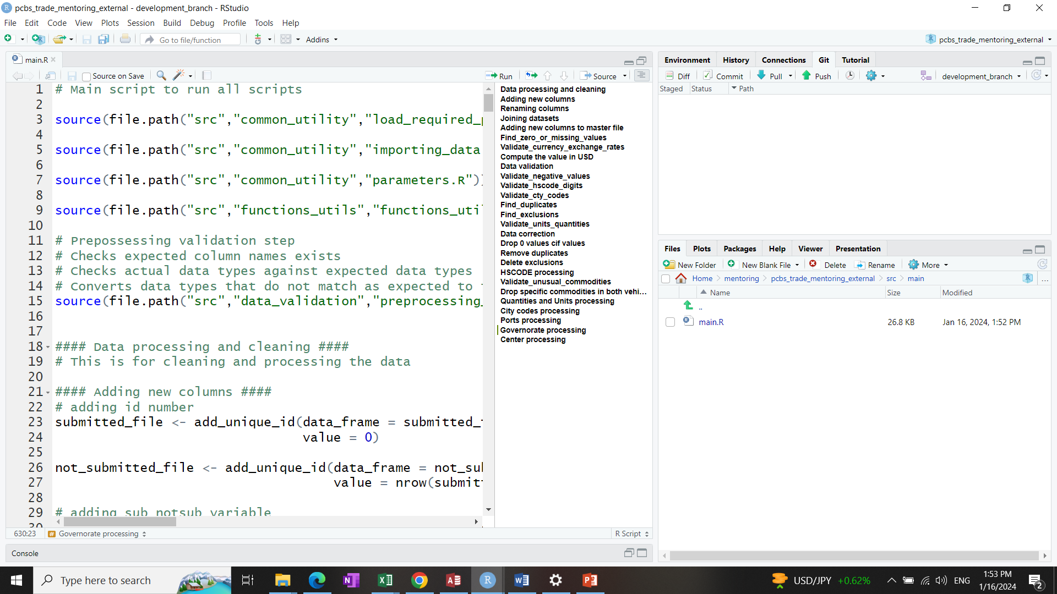
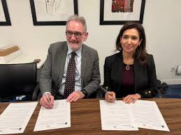
Introduction
The automation of trade statistics is one of the main topics of the MoU signed between PCBS, ONS, and Data Science Campus where it was agreed to start the automation process with one of the biggest data sources for trade statistics which is customs.
GDDS
SDDS
SDDS

Slide 8
"Custom declarations" as one of the biggest data sources was chosen as a pilot within the automation process. The file requires five working days due to the large number of rows The usually applied procedure in dealing with is based on Excel and Access databases.

Slide 9
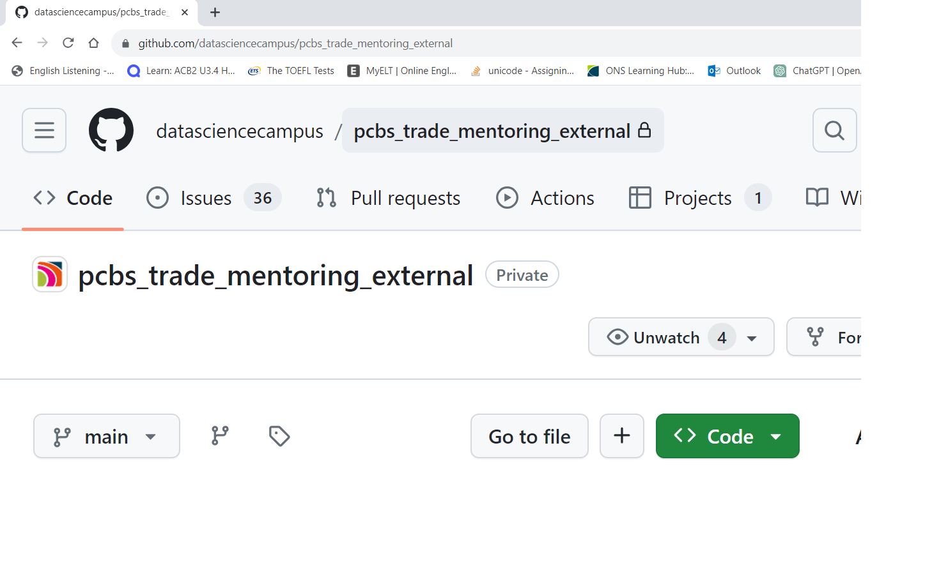
Recurring terms
RAP
Repository
GitHub
Synthetic data
Standard tools to make sure our analysis is reproducible, improve quality & efficiency.
It contains all of your project's files, revision history, and collaborator discussion.
Is an AI-powered developer platform that allows to create, store, and manage codes.
Is any data that is generated rather than observed confidential data.

Slide 10
Project Aspects
Git and GitHub to share code (in R) and exchange messages specifically related to code development
To develop data science skills in trade data processing and save resource, enhance reproducibility and consistency.
An automated process, coded in R
Weekly virtual sessions during 04/2023 - 12/2023.
Three mentors from Data Science Campus

Slide 11
Project Stages
Reporting and visualizing outputs
Running the pipeline/ the file is ready (processed)
Automating data validation/Processing
Creating the issues/Creating the branches
Importing the data
Creating Github Accounts & the repository
Mentoring/ data sharing agreements
PCBS Presentation

Slide 12
Create a repository

Slide 13
Creating an Issue

Slide 14
Translating the issue into a code

Slide 15
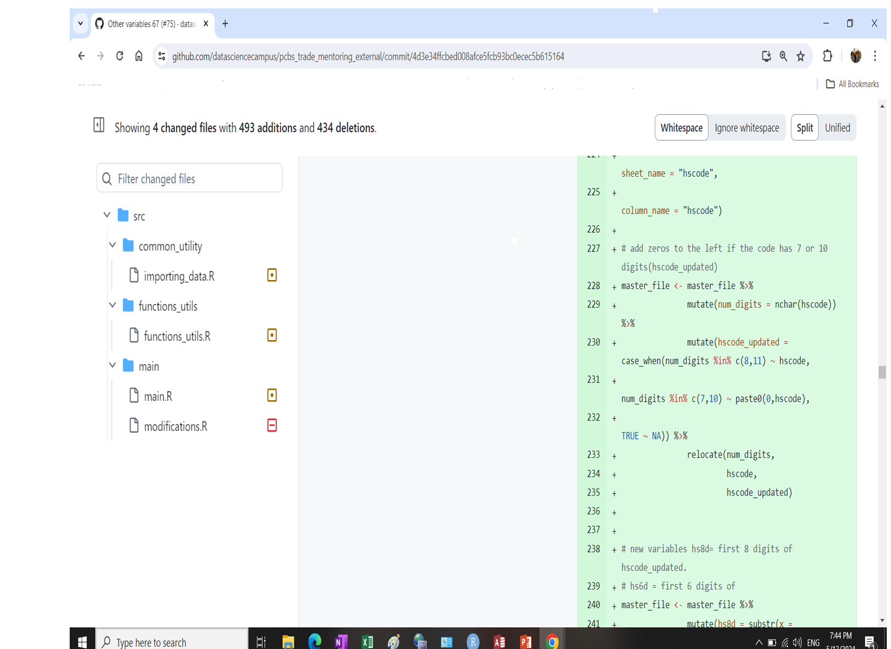
After pushing

Slide 16
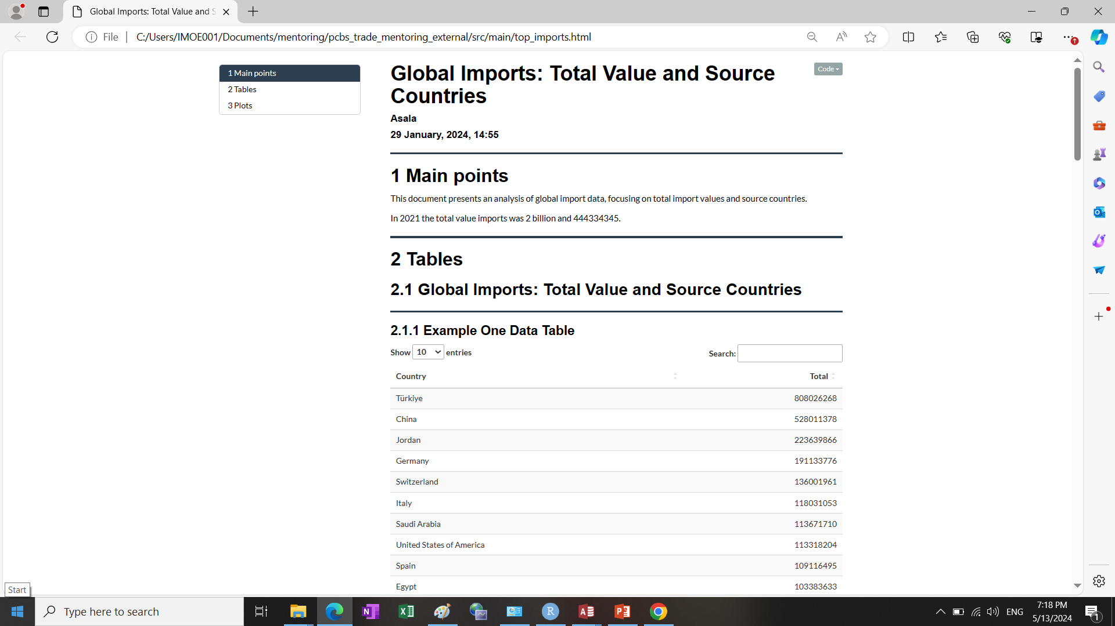
Results

Slide 17
Project Significnacy
Enhancing capacity building
for PCBS staff in R.
1
Reproducibility
2
3
For new data set you only need to check variables and change the parameters
Documintation
All the processing steps are written and then translated into codes using R.
4
Time efficiency
25-30 min compared to 5 days using the traditional process.

Slide 18
What’s next?
Continuously improve our classification method
- Explore hybrid (e.g., Fuzzy matching + LLMs) approaches, add more validation rules (e.g., utilize seller/buyer profiles), and consistently expand our labeled dataset with new data.
Aim to process VAT receipts using our new approach monthly rather than annually!
Incorporate this data source into our Business Intelligence Vision.
Seek more opportunities for cooperation with the ONS in different statistical areas.

Slide 19
A Step Towards Business Intelligence
ONS-PCBS Cooperation
Implemented

Slide 20
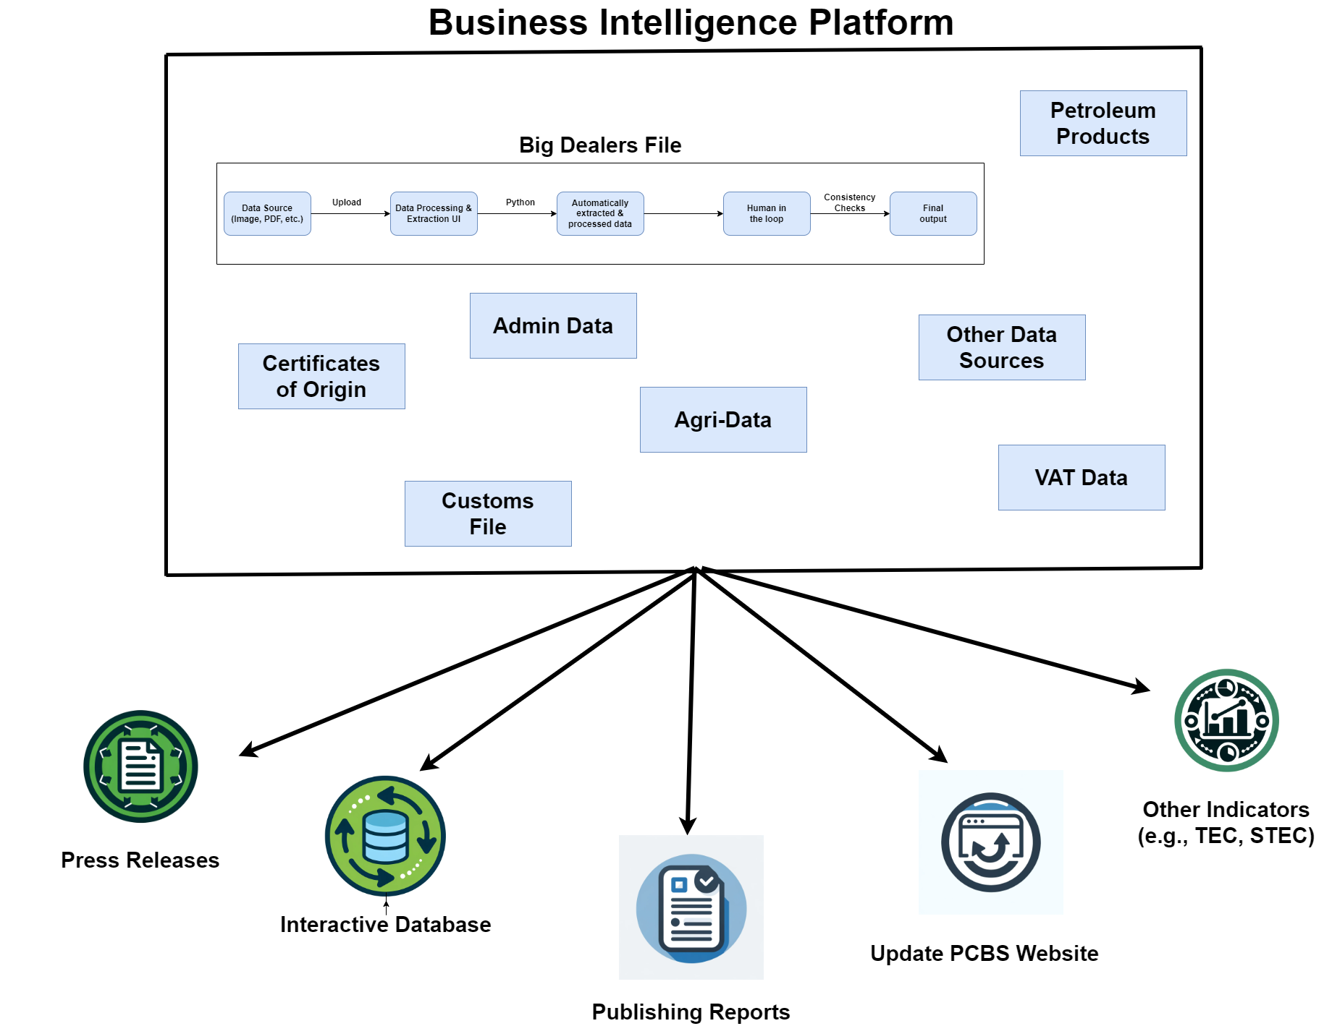
A Step Towards Business Intelligence

Slide 21
Don't be left behind; stay informed and vigilant

Slide 22
Thank you,,,

